Slide 1
GWU Data Analytics Bootcamp Project #1 Trends: Brewery, Winery & Distillery
Team:
Anna Bower | Seth Drewry | Bobby Jaikaran | Janice Lee

Slide 2
Project Scope/Overview
A summary of our efforts for Project 1

Slide 3
Project Overview
Analysis of nationwide distilleries, breweries, and wineries
Data was correlated to Census information
Mission to find relationships between demographics to number of each establishment
number of establishment by state
population by state for establishments
correlation between industries for establishments

Slide 4
Data Sources
Data Sources
https://beermapping.com/?lat=38.90010&lon=-77.04790&z=13
https://www.census.gov/data.html
https://www.data.gov

Slide 5
Results
Observations of Analysis

Slide 6
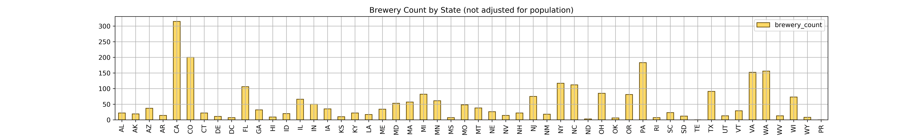
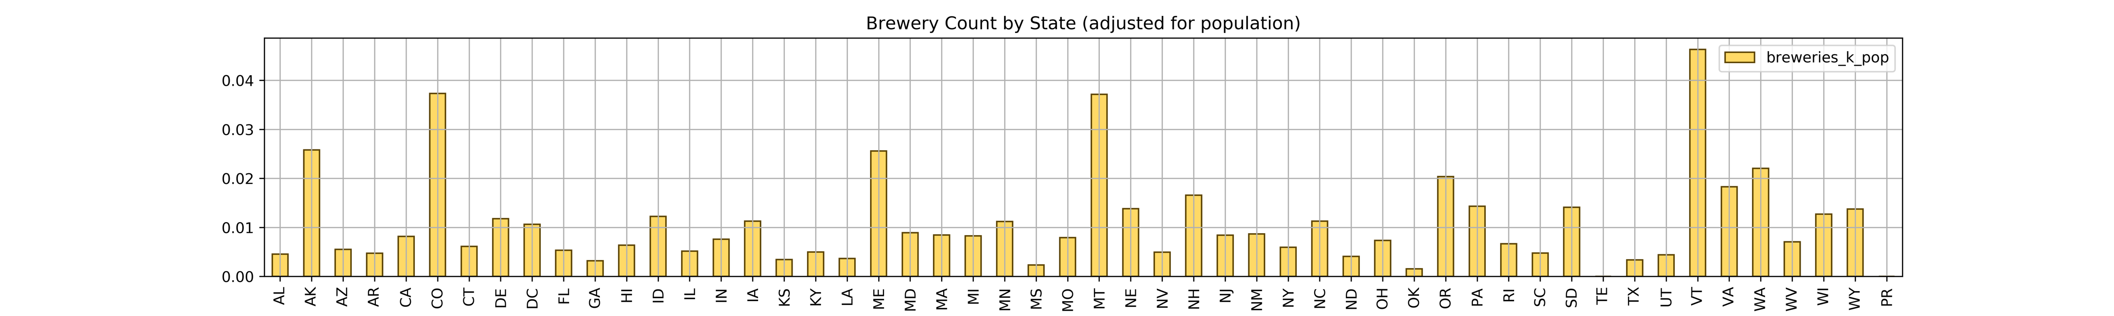
Other API
Brewery Count by State

Slide 7
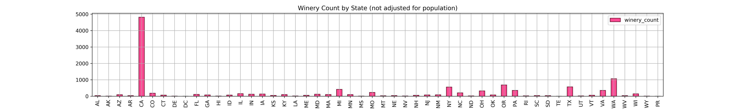
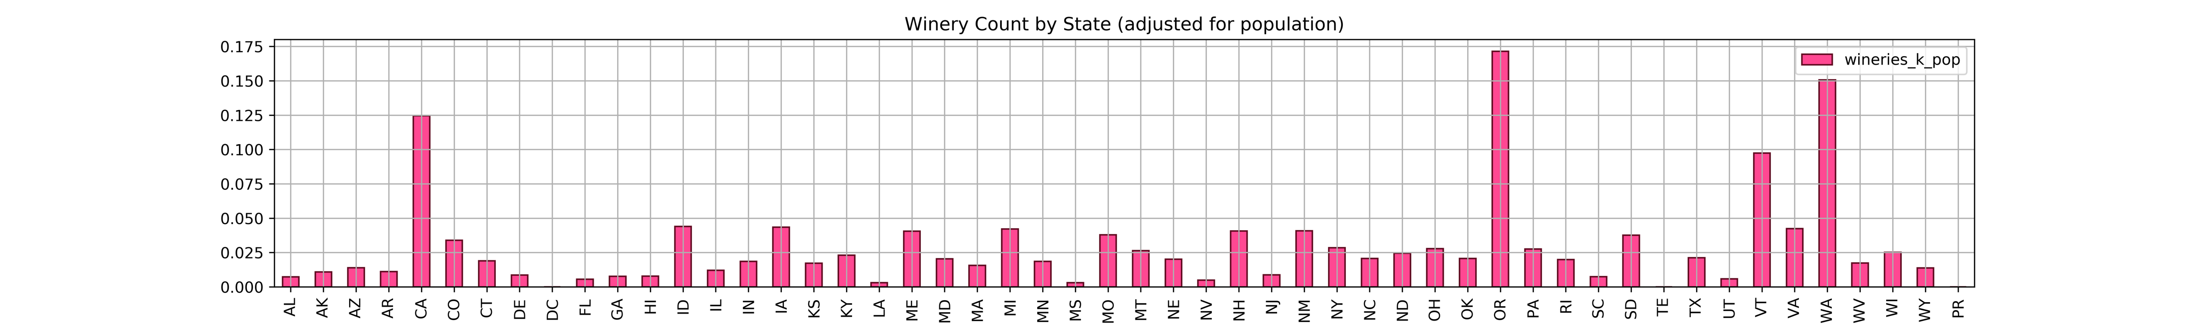
Other API
Winery Count by State

Slide 8
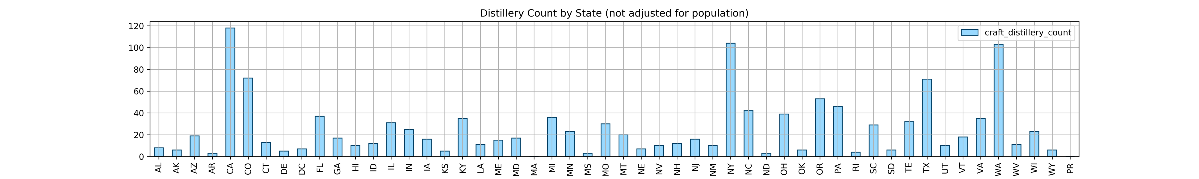
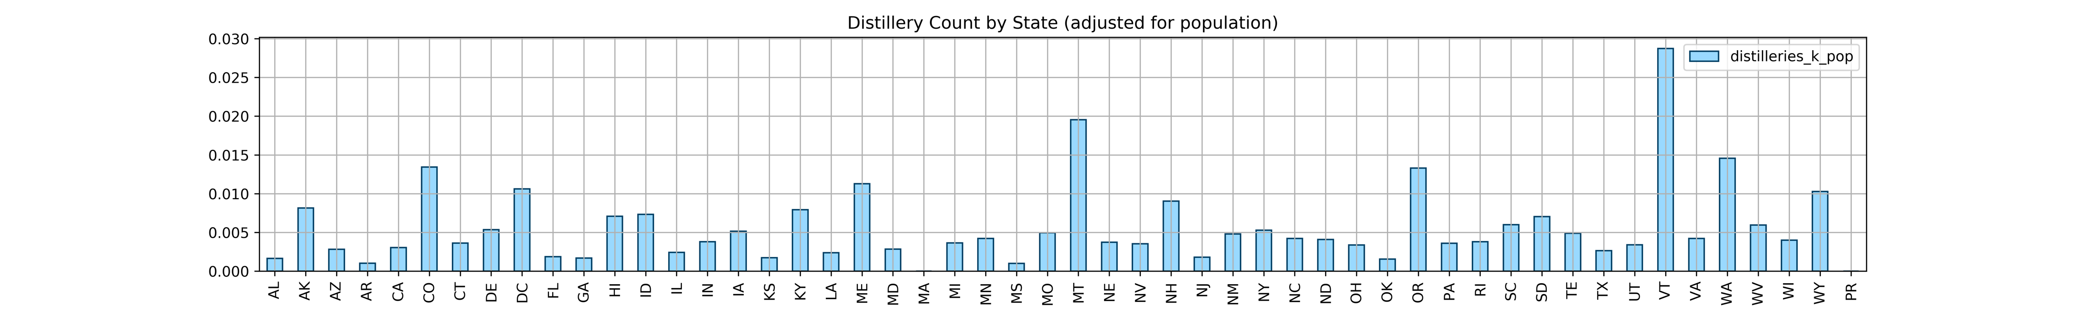
Other API
Distillery Count by State

Slide 9
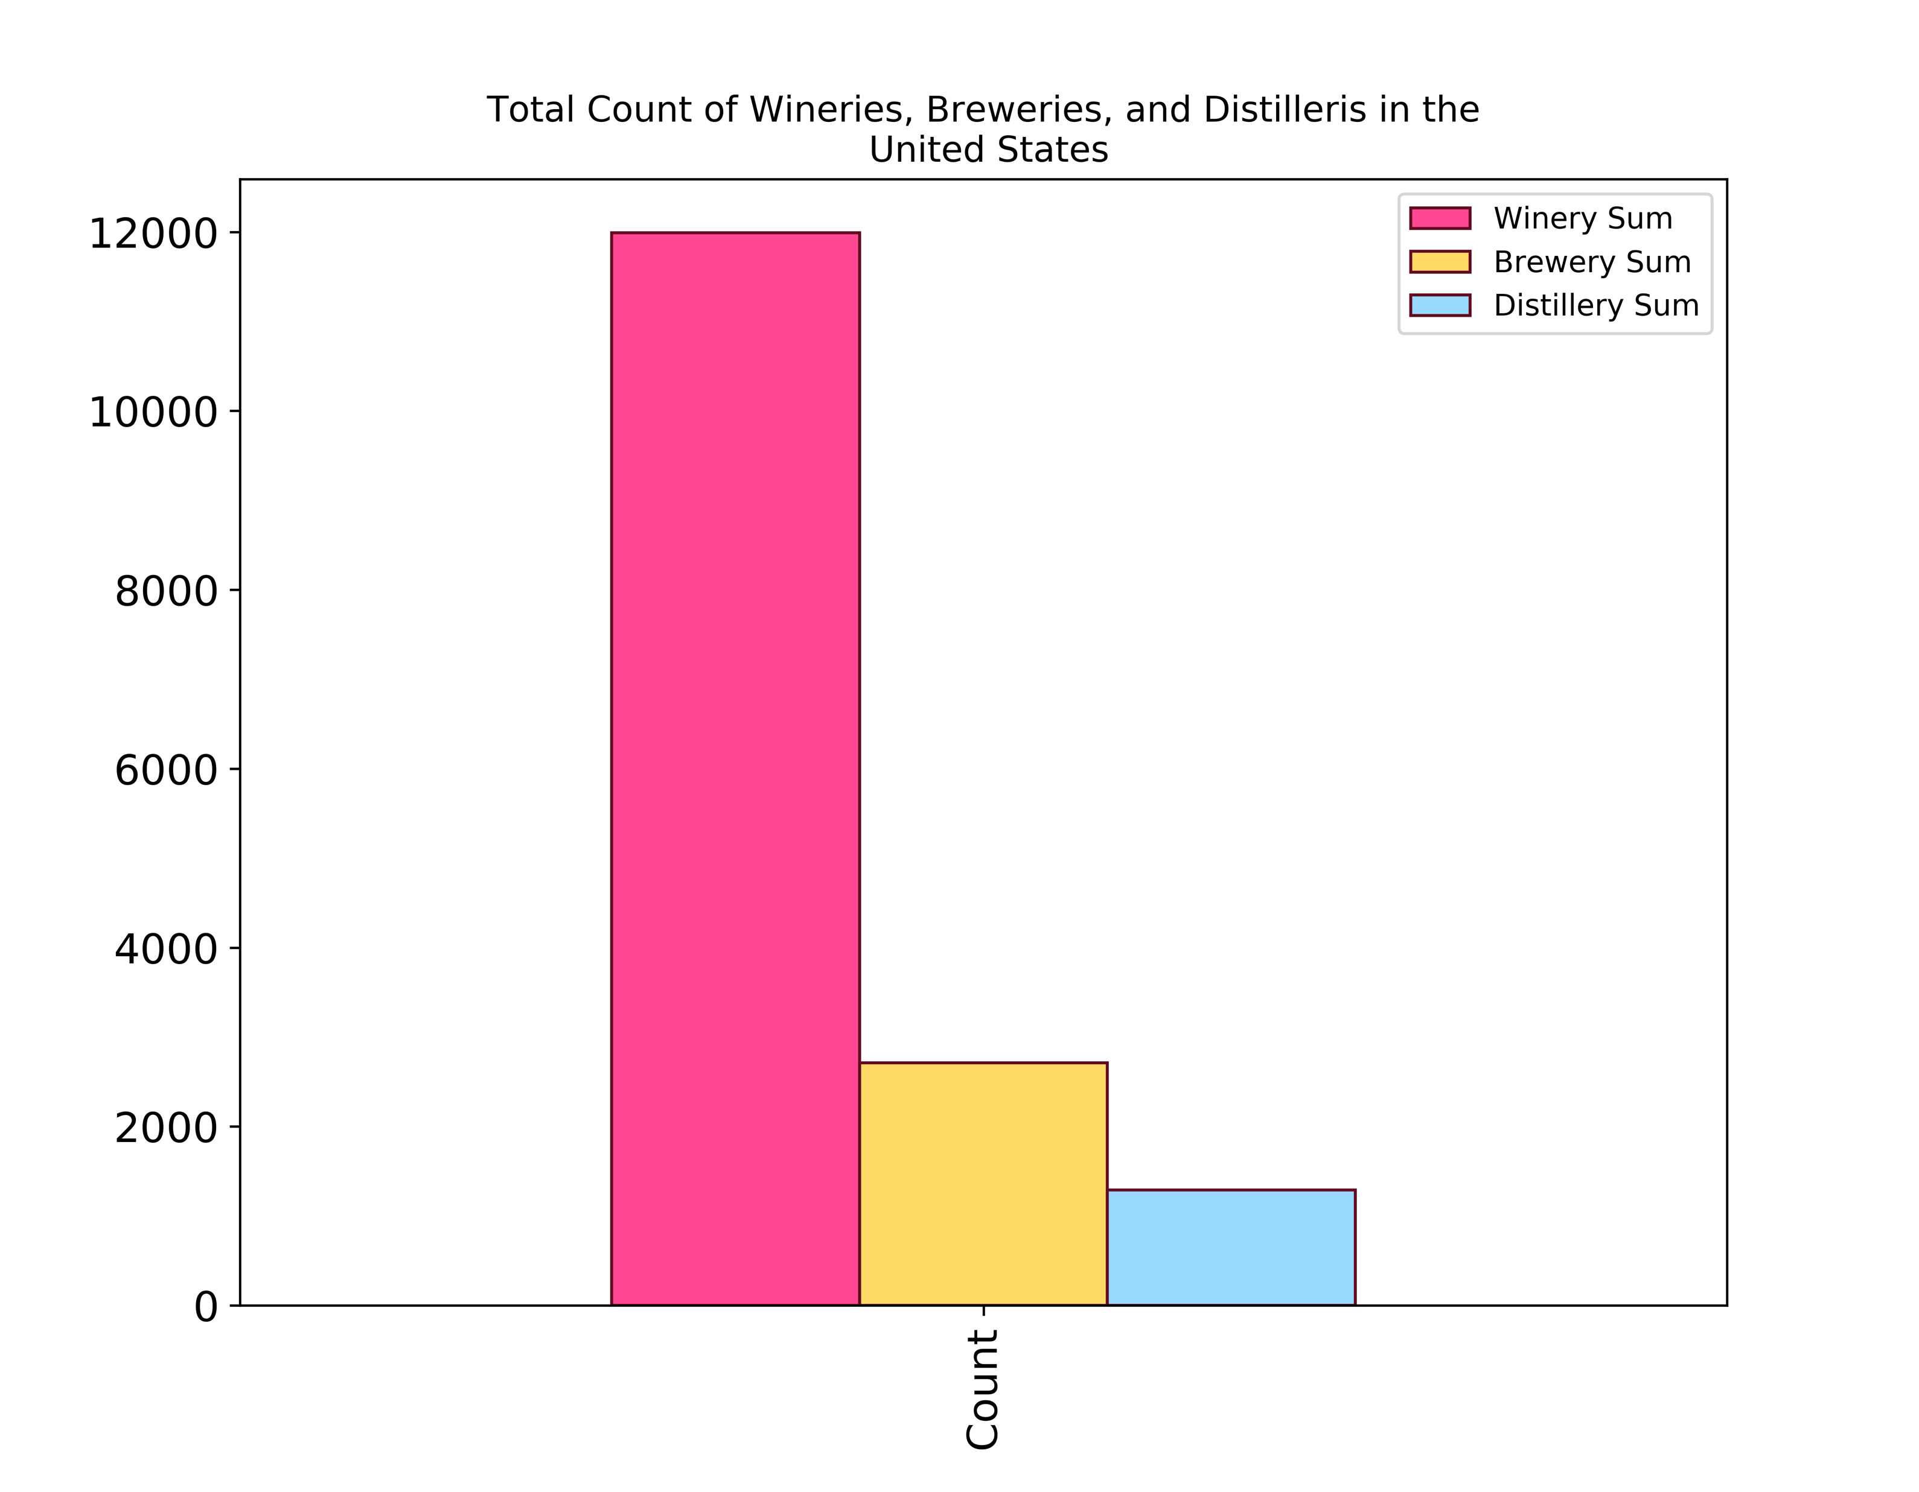
Other API

Slide 10



Google API

Slide 11
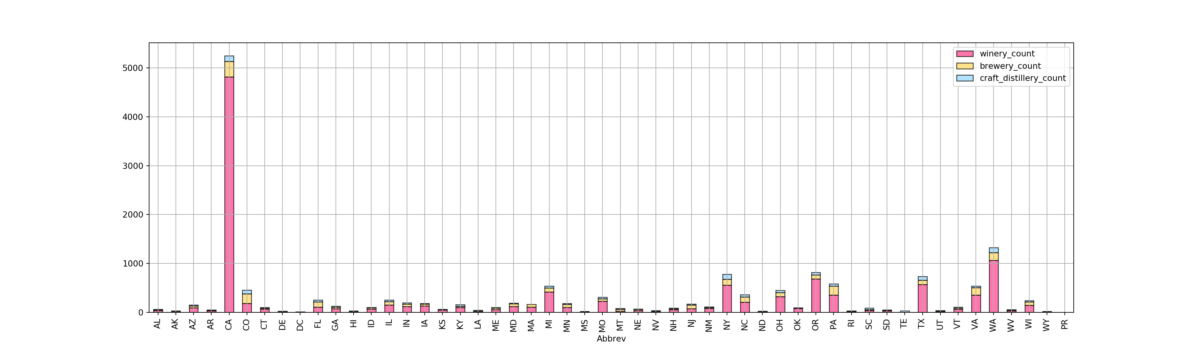
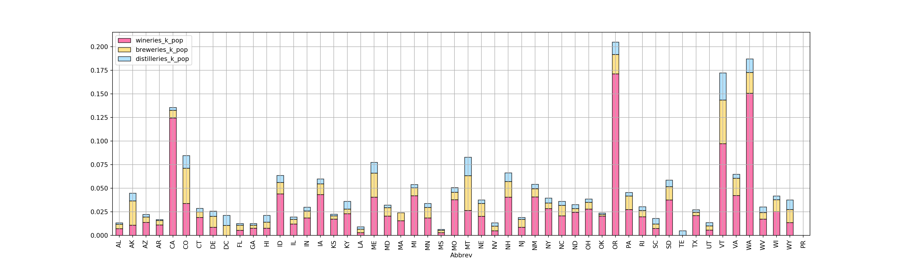
Google API

Slide 12
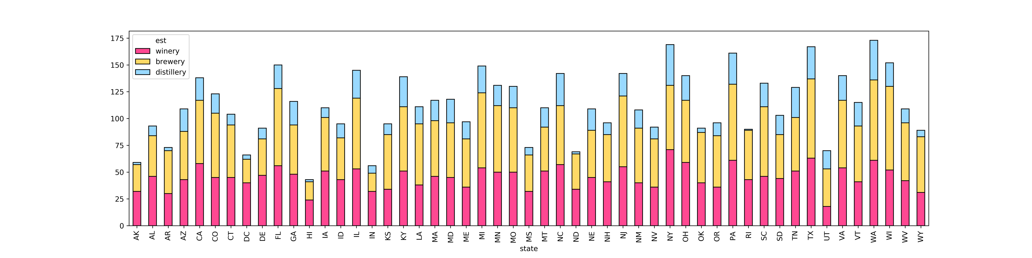
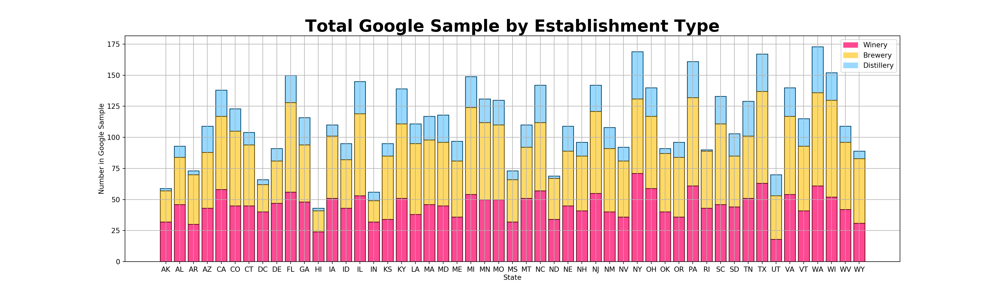
Google API

Slide 13
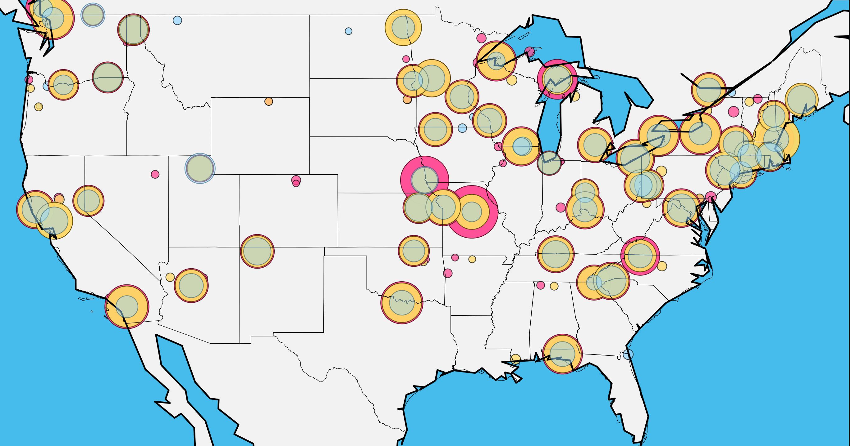
Google Map Sample by Establishment Type

Slide 14
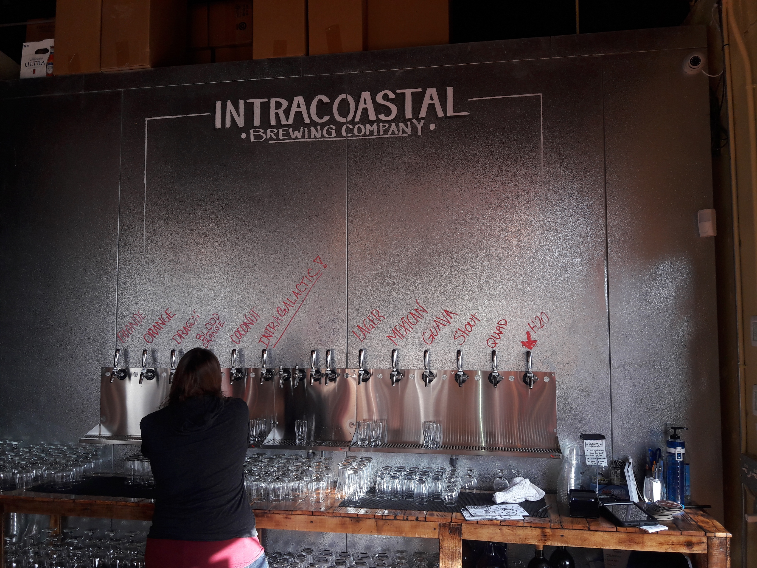

Slide 15
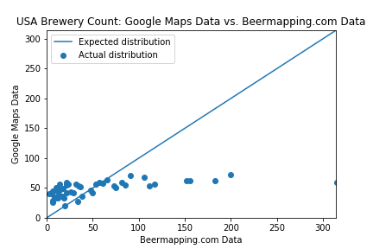
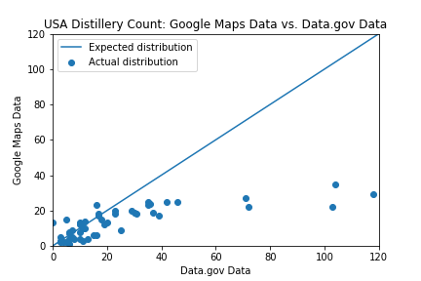
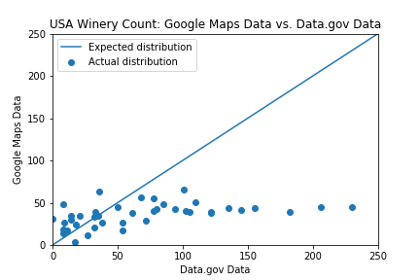
Comparisons of Data Sources
Although we expected to see a similar count (close to 1:1) between data sources, we actually found a significant discrepancy between Google Data and Other data sources

Slide 16
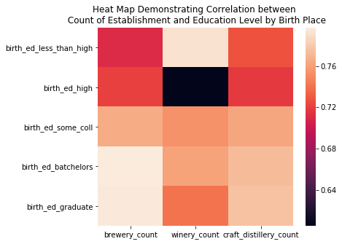
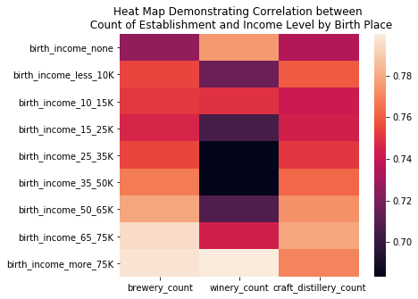
Correlation between counts of establishments and different variables yielded interesting conclusions warranting further analysis
Breweries and distilleries show an increasing correlation with higher education levels
Wineries show a different pattern, with a higher correlation for less than high school education
Breweries and distilleries show an increasing correlation with income levels
Wineries show a different pattern, with a higher correlation for less than high school education and greater than 75K

Slide 17
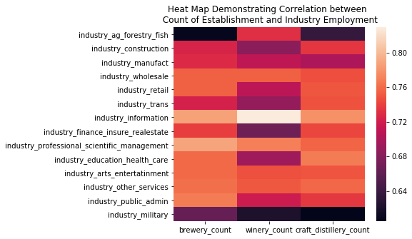
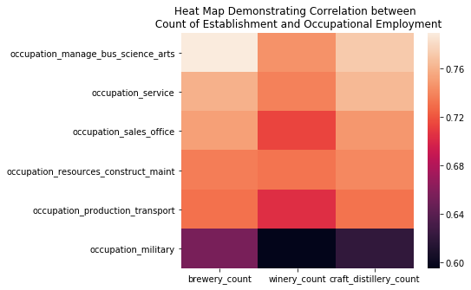
Correlation between counts of establishments and different variables yielded interesting conclusions warranting further analysis
Highest correlations for people in the information industry and scientific management industries across the board
Lowest correlations for military
Highest correlation for people who are in management, business, science and artistic occupations
Lowest correlation for military

Slide 18
Challenges and Resolutions
Challenges
Performing Google API calls and hitting daily rate limit
Inconsistency with naming convention when merging data frames
Different types of data files provided from sources
Obtaining and preserving the accurate numeric data type
Naming conventions for States and US Territories (full name vs. abbreviations)
Aligning on the definition of terms
Resolutions
Utilized data.gov and obtained csv files for wineries and distilleries by states
Searched for common identifiers and renamed it for consistency when merging data frames
Converted data set to one type of file for consistency

